Slide 1

Agronet
By Team Vision

Slide 2
Team vision members/ Our track
Kush Kaushik
Manas Dhawan
Ayush Singh
Kartikeya Hazela
Rudraksh Dubey
FoodTech
Farmers are giving up their lives just to pay back loans. It's heartbreaking to see them struggle
so much to feed us. We need to remember where our food comes from and support our farmers.
As a farming state, we can do better. Let's work together to make sure farmers have a better life and can
keep providing us with food.

Slide 3
Problem statement
There are multiple challenges in the pursuit of maximizing crop yields. Environmental factors like climate change and soil degradation.
Economical factors like market fluctuation and rising cost.

Slide 4
Solution
Our platform leverages advanced data analytics and
algorithms to provide farmers with:
Real-time market trend analysis:
Accurate and up-to-date information on crop prices,
demand, and supply.
Harvest cost estimation:
Precise predictions of production
costs based on factors such as location, time, and crop type.
Personalized crop recommendations:
Tailored suggestions
for crops that are likely to yield maximum
profits based on the farmer's specific circumstances.
By empowering farmers with this data-driven insights,
we aim to reduce risk, increase profitability, and promote
Sustainable agricultural practices.

Slide 5


TARGET AUDIENCE
PRIMARY AUDIENCE
Around 58% of India's population is dependent on agriculture, either directly or indirectly this primary audience of Agronet includes Small to Medium scale farmers who need data driven insights to optimize their crop yield whilst minimizing risk and improve profit.
SECONDARY AUDIENCE
The secondary audience for Agronet includes agro-industries, cooperatives, agribusinesses, and financial institutions. These organizations can leverage the platform's data analytics for supply chain optimization, market trend predictions, and risk assessment.

Slide 6
FEASIBILITY
Complete Coverage: The model integrates data from 602 districts nationwide, ensuring that insights and recommendations are relevant and localized for farmers across the country
Language Support: With support for multiple local languages, the platform is accessible to farmers from diverse linguistic backgrounds, enhancing usability and reach.
Cross-Platform Accessibility: As a web-based solution, the platform can be accessed on any device, providing farmers with the flexibility to use it on smartphones, tablets, or computers.
User-Friendly Interface: The model features a simple user interface, making it easy for farmers, regardless of their tech proficiency, to navigate and utilize the platform effectively.

Slide 7

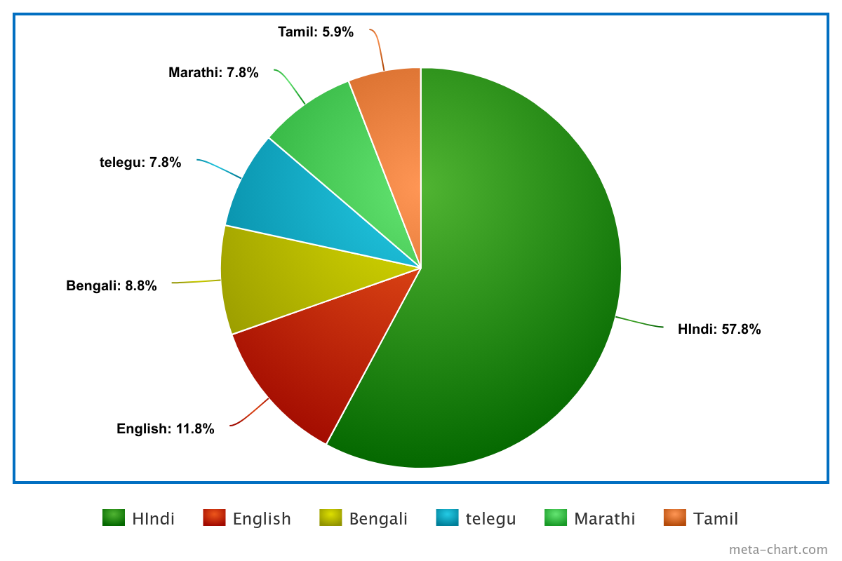
Technical approach
MULTILINGUAL SUPPORT
for local language usage we can use iNLTK (Indian Natural Language Toolkit) which is designed to support various local languages of India like Hindi,Bengali,Kannada, Tamil,Telugu,Malayalam,Punjabi
*Note English is 99% of the time used as a secondary language

Slide 8



TECHNICAL APPROACH
Machine Learning and NLP:
TensorFlow and Keras for deep learning and NLP tasks, RandomForest Regressor for price prediction.
Multilingual Support:
iNLTK for processing and understanding multiple Indian languages.
Weather Analysis:
Integration with weather prediction APIs to acquire and analyze weather data.

Slide 9



Scalability
To scale the project, we plan to partner with the Ministry of Agriculture and agricultural institutions, which will help expand the project to various regions.
Future Partnerships: We aim to collaborate with agro firms to create a B2B approach, similar to what Amul does in the milk industry.
Procurement Strategy: Instead of just predicting prices, we plan to procure crops from farmers at a fixed rate, displayed on the website during the sowing season, and then sell them to agro businesses.
Marketplace Creation: This approach will create profits and establish a marketplace for agro businesses, benefiting both farmers and the industry.

Slide 10
impact
The farmer issue is a major crisis in the country, with frequent roadblocks occurring every month.
The Shambu border has been sealed for nearly two years, highlighting the severity of the situation.
This project empowers farmers by giving them direct access to market data, reducing their dependency on the government and, in turn, alleviating pressure on the government as well.
The project will positively impact farmers nationwide by significantly increasing their profits.
It offers real-time market prices and predicts prices at the time of harvesting, enabling farmers to choose crops that will yield the highest profit during the sowing period.

